Slide 1
Civic Data VR
Can government use of Data VR make open, public data more accessible, useful, and impactful?
Jan 23, 2017
MIT Media Lab
Patrick McCormick
paddy@post.harvard.edu
@solutist

Slide 2
Civic Data VR
Great expectations for public data
Mainstream but not game changing
Open data growth
Pattern recognition through Data VR
Public policy and service delivery
Government accountability
Citizen engagement

Slide 3
Great expectations for public data
Establish Identity, Privacy, and Security policies
Develop, publish Open Data policy
Align to Government Open Data principles
Complete: all public data not subject to privacy, security, privilege limits, is made available
Primary: Data is as collected at the source, with highest possible level of granularity, not in aggregate or modified forms
Timely: Data is made available as quickly as necessary to preserve value
Accessible: Data is available to widest range of users for widest range of purposes
Machine processable: Data is reasonably structured to allow automated processing
Non-discriminatory: Data is available to anyone, with no requirement of registration
Non-proprietary: Data is available in format over which no entity has exclusive control
License-free: Data is not subject to any copyright, patent, trademark or trade secret regulation (reasonable privacy, security and privilege restrictions may be allowed)
principles of open government data: https://public.resource.org/8_principles.html

Slide 4
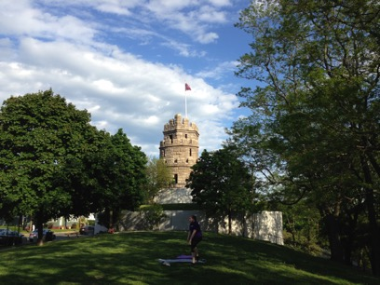
Mainstream but not game changing
Tim Berners-Lee’s 5 star framework for open data:
* Data available with open license but not machine readable
** Data available, machine readable in proprietary formats
*** Data available, machine readable in non-proprietary formats
**** Data available using open linked formats
***** Data available, linked with other relevant data
wikipedia

Slide 5
Open data growth
Tapping into the knowledge of citizens
Open connectivity, shared data, APIs, sensors, IoT, apps
Opening up decision making, planning processes
Providing responsive municipal services
Improving traffic and crisis management
Mapping urban flooding and air pollution
Enabling collaborative smart energy and sustainability
Informing continuous urban design, embedded analytics
Terms:
PII: Personally Identifiable Information - sensitive info
P2P: Peer to Peer production – collaboration, crowdsourcing
IoT: Internet of things – device to device communication
Big data: high volume, often unstructured, use of pattern recognition

Slide 6
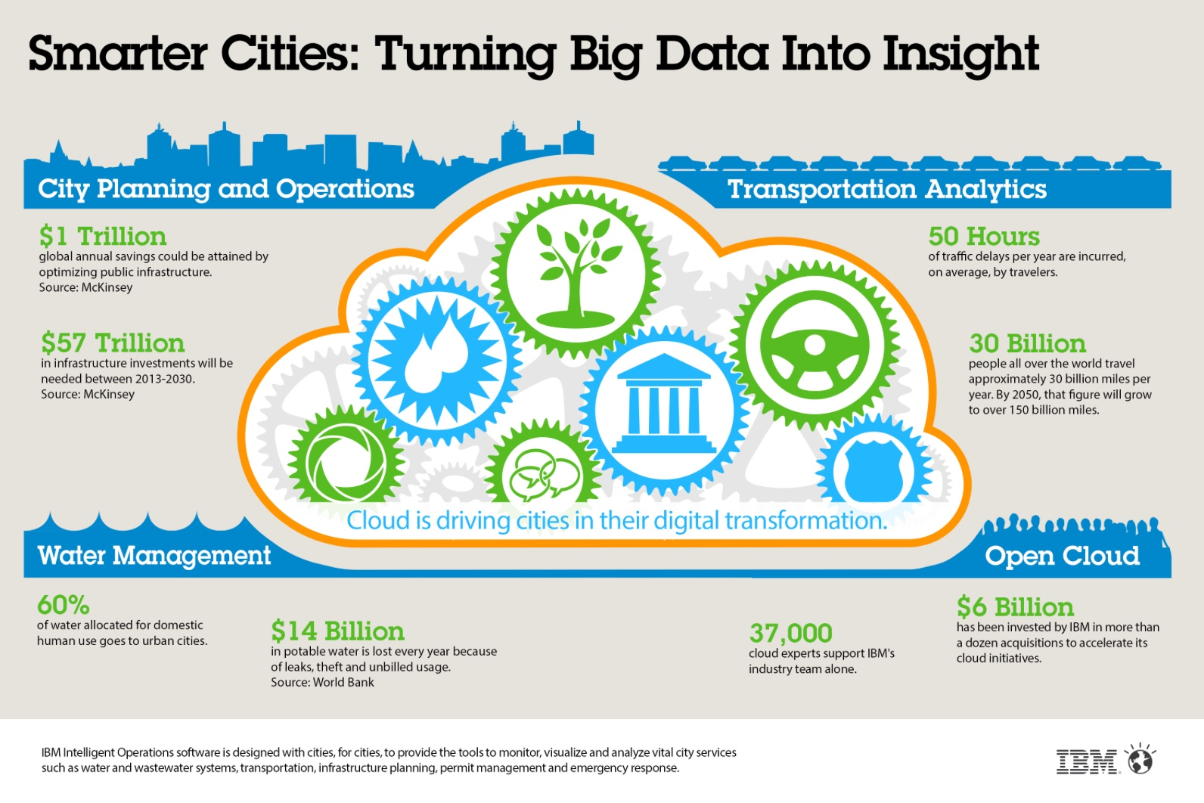

Slide 7
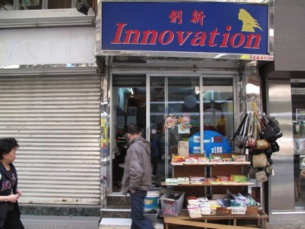

Pattern recognition through Data VR
Public policy and service delivery
Government accountability
Citizen engagement

Slide 8
Pattern recognition through Data VR
Challenges
resources
legacy IT systems
legacy business processes
data custodianship
measurable outcomes
PII
Opportunities
evidence based policy
operational efficiency
cross-sector collaboration
new revenue sources
improved data
Public policy and service delivery
Government accountability
Citizen engagement

Slide 9
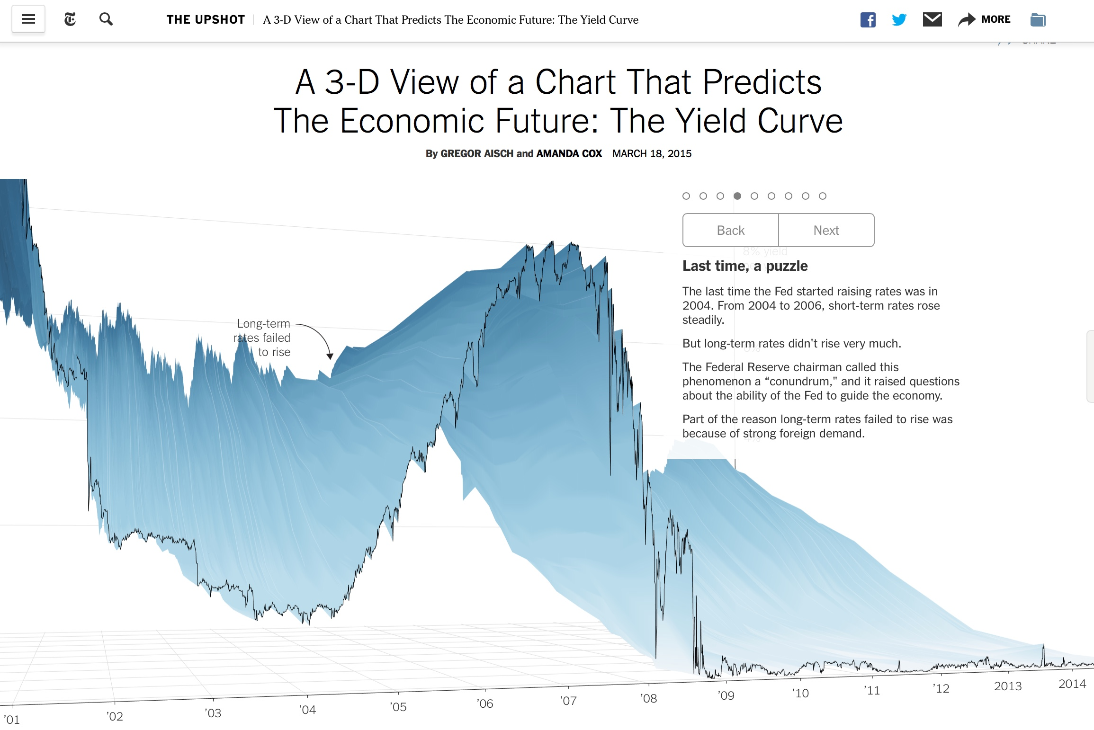
https://www.nytimes.com/interactive/2015/03/19/upshot/3d-yield-curve-economic-growth.html?smid=fb-nytupshot&smtyp=cur&_r=0

Slide 10
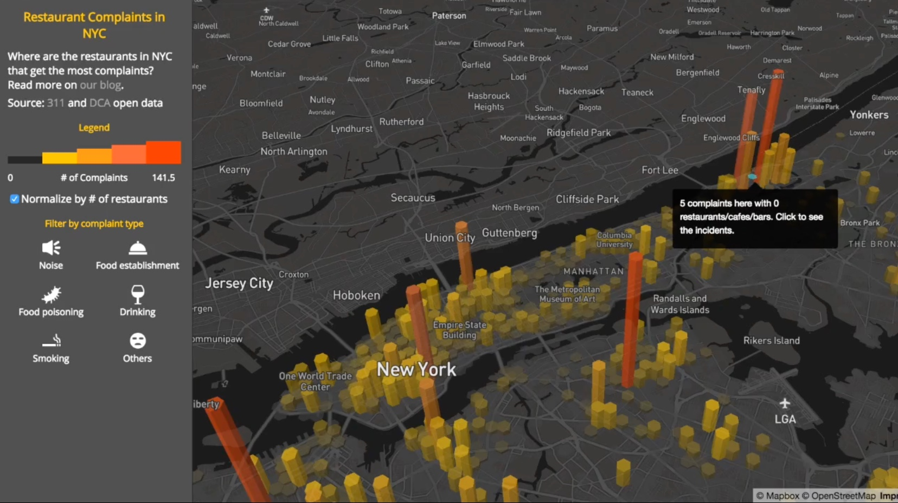
Pattern recognition through Data VR
each 311 incident and restaurant is geocoded to the nearest street centerline
https://www.mapbox.com/blog/3d-hexbin/

Slide 11
Pattern recognition through Data VR
Engaged community contributes to open data and smart services
Proximity to universities, knowledge economy resources
Real-time monitoring to address water leaks, sewer and drainage issues
Transport apps ease multi-modal mobility
Responsive trash collection, maintenance save time and money
Street parking availability apps, dynamic pricing, smart parking garages
Smart lighting improves safety, efficiency, quality of life

Slide 12
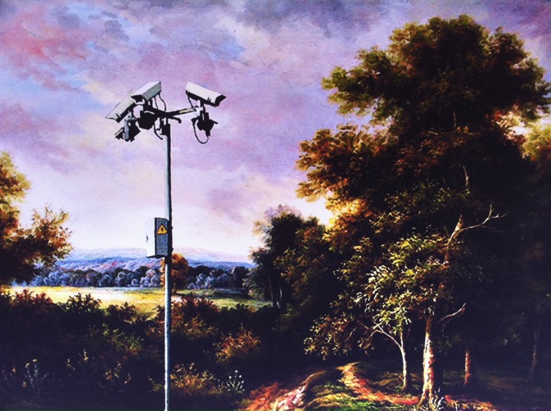
Pattern recognition through Data VR
Public policy and service delivery
Government accountability
Citizen engagement
Banksy

Slide 13
re-using this presentation? the fine print…
Parts of this presentation not under copyright or licensed to others (as indicated) have been made available under the Creative Commons Licence 3.0
Put simply, this means:
you are free to share, copy and distribute this work
you can remix and adapt this work
Under the following conditions
you must attribute the work to the author:
Patrick McCormick (paddy@post.harvard.edu)
you must share alike – so if you alter or build upon this work you have to keep these same conditions
Unless stated otherwise, the information in this presentation is the personal view of the author and does not represent official policy or position of his employer

